Slide 1
Auburn-USDA CS Clinic
Liaison Meeting (3/27/25)

Slide 2
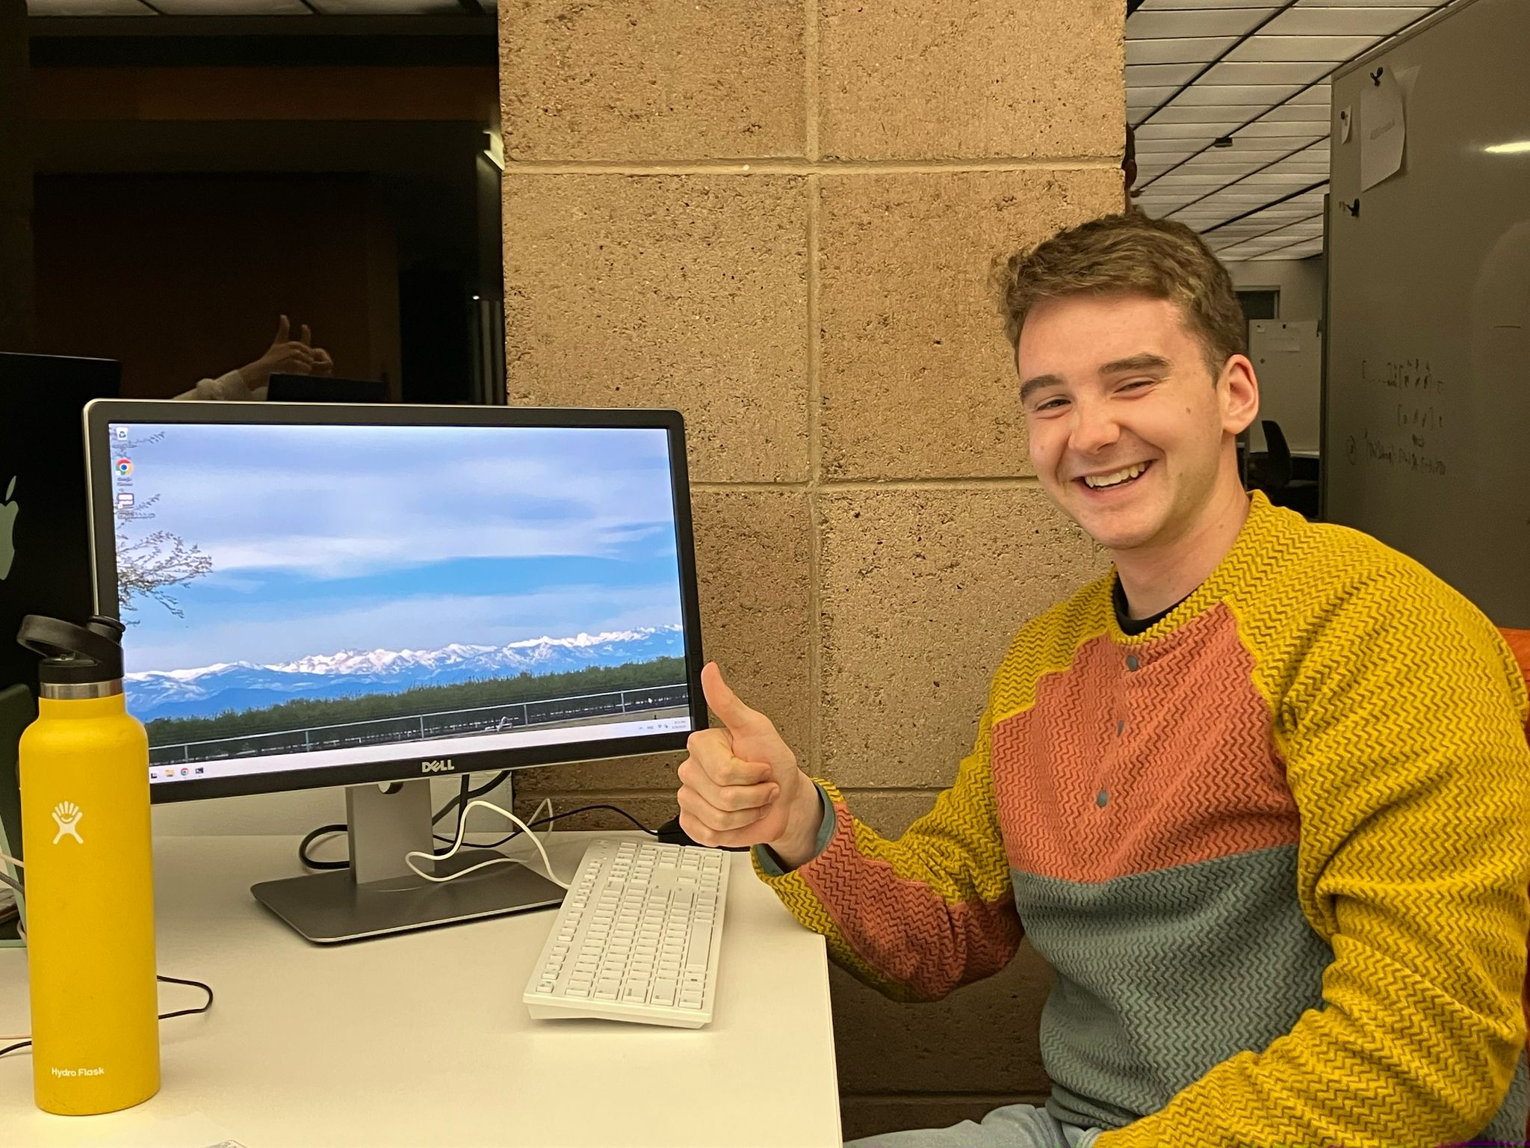

Slide 3
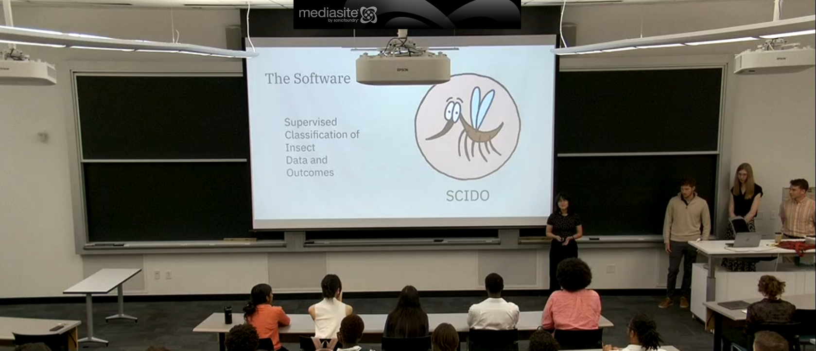
Our presentation went well!

Slide 4
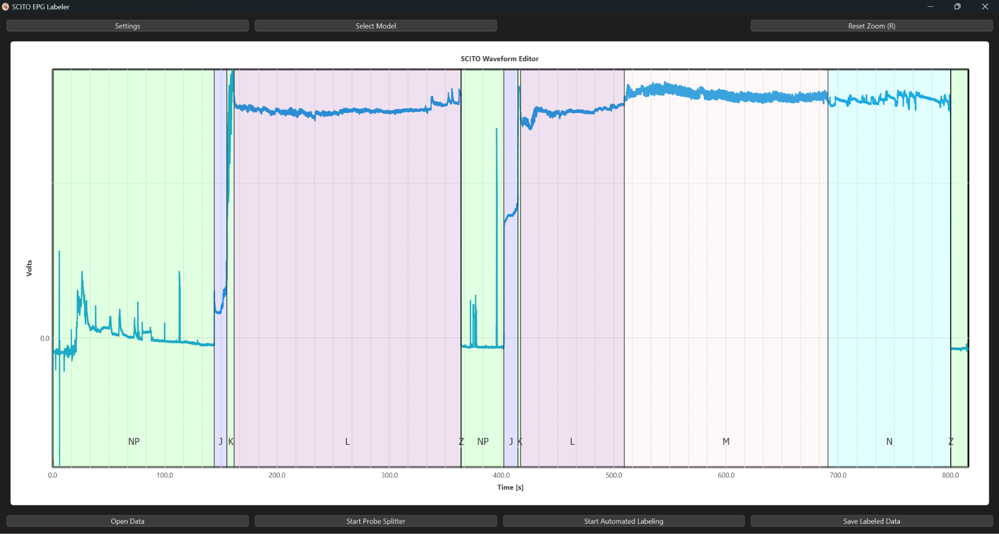
GUI Updates

Slide 5
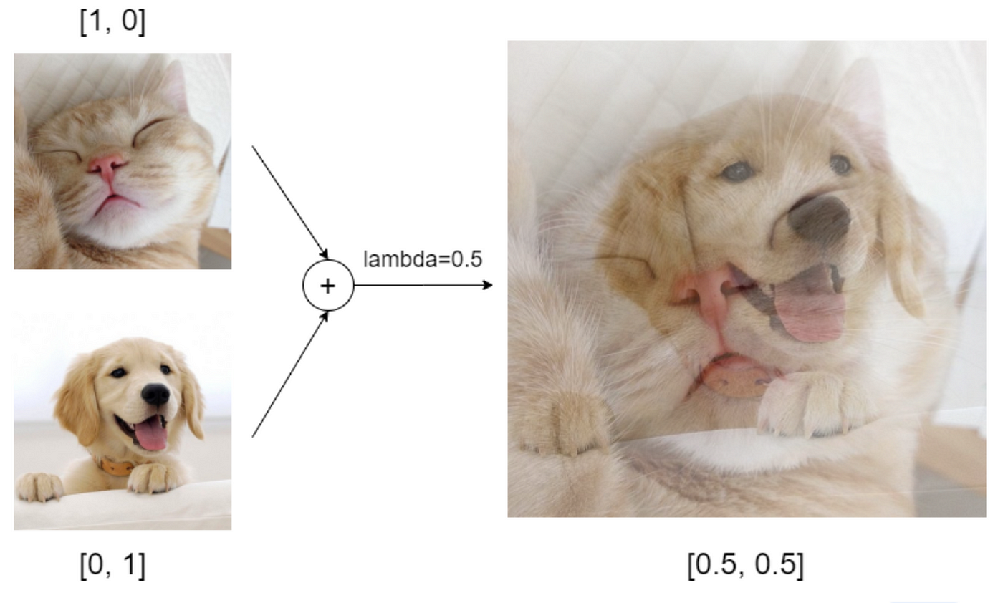
ML Updates
Finalized Data Augmentation Regime
Given our data, it makes the most sense to only use Franken-data and scaling augmentations
Mixup would be cool to add, but doing so would require us to make changes to nearly all of our data-processing code
While we hope augmentations make a difference, we will need to see if that is true next week
Hyperparameter Tuning
All of our models are set up for running tuning this next week.
UNet Improved!
Results will be detailed in our report for Dr. Cooper next week
Example of Mixup

